Slide 1
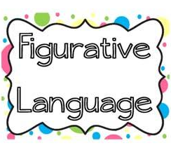
Bell Ringers
Notes:
https://docs.google.com/presentation/d/1Nadwqr8hKmot4WD4JgxjidKxGaeMEbptkFSTHHKKXx8/ + preview?rm=minimal&slide=

Slide 2
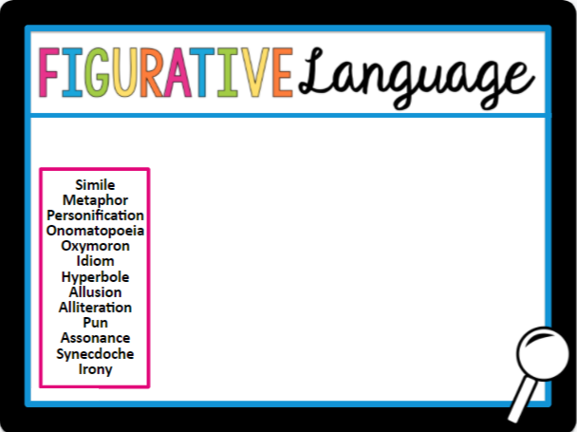
Simile
One common type of figurative language is the simile. A simile makes a comparison between two unlike things, using like or as. As hot as an oven, as cold as ice, and ate like a pig are all examples of similes, although they are not very original ones.

Slide 3
Metaphor
Metaphors, like similes, make a comparison between two unlike things. Unlike similes, however, metaphors do not use the words like or as.
She fought like a lion is a simile.
She was a lion in battle is a metaphor.

Slide 4
Personification
Personification is a literary device that gives human attributes to a nonhuman object. For example, the wind whined in the leafless trees is personification. Wind does not whine; people (unfortunately) do.

Slide 5
Onomatopoeia
Onomatopoeia refers to words that come from sounds. These poetic lines use onomatopoeia:
“This is the way the world ends Not with a bang but with a whimper.”
by T.S. Eliot, “The Hollow Men”

Slide 6
Oxymoron
An oxymoron contains words that seem to contradict each other. Common oxymorons include the same difference, act naturally, and bittersweet.

Slide 7
Idiom
An idiom is a set expression or a phrase comprising two or more words that is understood to mean something different from what the individual words of the phrase suggest.
Kirk: “If we play our cards right, we may be able to find out when those whales are being released.”
Spock: “How will playing cards help?

Slide 8
Hyperbole
Hyperbole, or overstatement, is a literary device that uses exaggeration. Someone who describes the cafeteria line as “twenty miles long” is using hyperbole.

Slide 9
Allusion
An allusion is a reference to something from a well-known source, such as the Bible, mythology, literature, or historical events. If someone is described as having a Jekyll-and-Hyde personality, this is an allusion to the novel, The Strange Case of Dr. Jekyll and Mr. Hyde.

Slide 10
Alliteration
Alliteration is the repetition of an initial consonant sound, such as in slithering snake, and lonely, lingering light. Alliteration is a sound device used to create a feeling or association. Alliteration is often used in poetry, but it may be used in prose as well.

Slide 11
Pun
Puns involve words with similar or identical sounds but with different meanings.
Denial (“The Nile”) isn’t just a river in Egypt.
The cyclist was two (“too”) tired to win the race.

Slide 12
Assonance
Assonance is the repetition of similar vowel sounds takes place in two or more words in proximity to each other within a line of poetry or prose.
Goodnight, sleep tight, don’t let the bedbugs bite.
Winner, winner, chicken dinner!

Slide 13
Synecdoche
Synecdoche is a literary device in which a part of something represents the whole, or it may use a whole to represent a part.
The word “sails” refers to a whole ship.
The word “suit” refers to a businessperson.

Slide 14
Irony
Irony is a literary device in which contradictory statements or situations reveal a reality that is different from what appears to be true. This can be in the form of an unforeseen outcome of an event, a character’s unanticipated behavior, or something incongruous that is said.
Telling a quiet group, “don’t everybody speak all at once.”
A fire station that burns down.

Slide 15
Cliché
A cliché is a phrase or expression that has been used so much that it does not feel fresh or original anymore. It is like a popular saying that people use over and over again, so it gets worn out.
Time flies when you're having fun!
This assignment will be a piece of cake.

Slide 16
Paradox
A (verbal or literary) paradox is simultaneously self-contradictory and yet also reveals unexpected meaning—often depending on words that can be interpreted in more than one way. Paradox is distinct from antithesis and oxymoron.
Hamlet tells his mother, "I must be cruel, only to be kind."
From 1984: “War is peace. Freedom is slavery. Ignorance is strength.”

